Slide 1
Application of Implicit Neural Representation in Tomography Imaging
Yuyao Zhang, PhD.
ShanghaiTech University-SIST-SMIRC center
Nov. 2022

Slide 2
Motivation
To guide a process of modeling practical problems using cutting-edge technique.
To evaluate my hypothesis that no one can model the same problem in entirely the same way as you do.

Slide 3
Outline
Definition of tomography imaging;
Release the problem to solve with an additional discussion to clarify the setup;
A fast revisit of implicit neural representation and NERF;
Discussion in groups;
A presentation of the model you would like to propose;
Discussion and summary of the proposed methods and the related state-of the arts methods review.

Slide 4
Outline
Definition of tomography imaging;
A fast revisit of implicit neural representation and NERF;
Release the problem to solve and a discussion to clarify the setup;
Discussion in groups;
A presentation of the model you would like to propose;
Discussion and summary of the proposed methods and the related state-of the arts methods review.

Slide 5
Tomography Imaging Overview

Slide 6
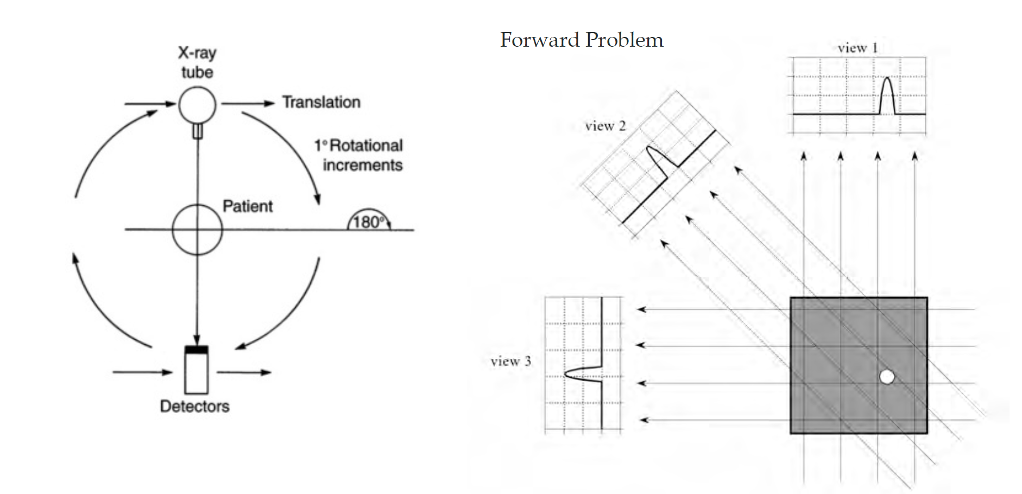
Computed Tomography

Slide 7
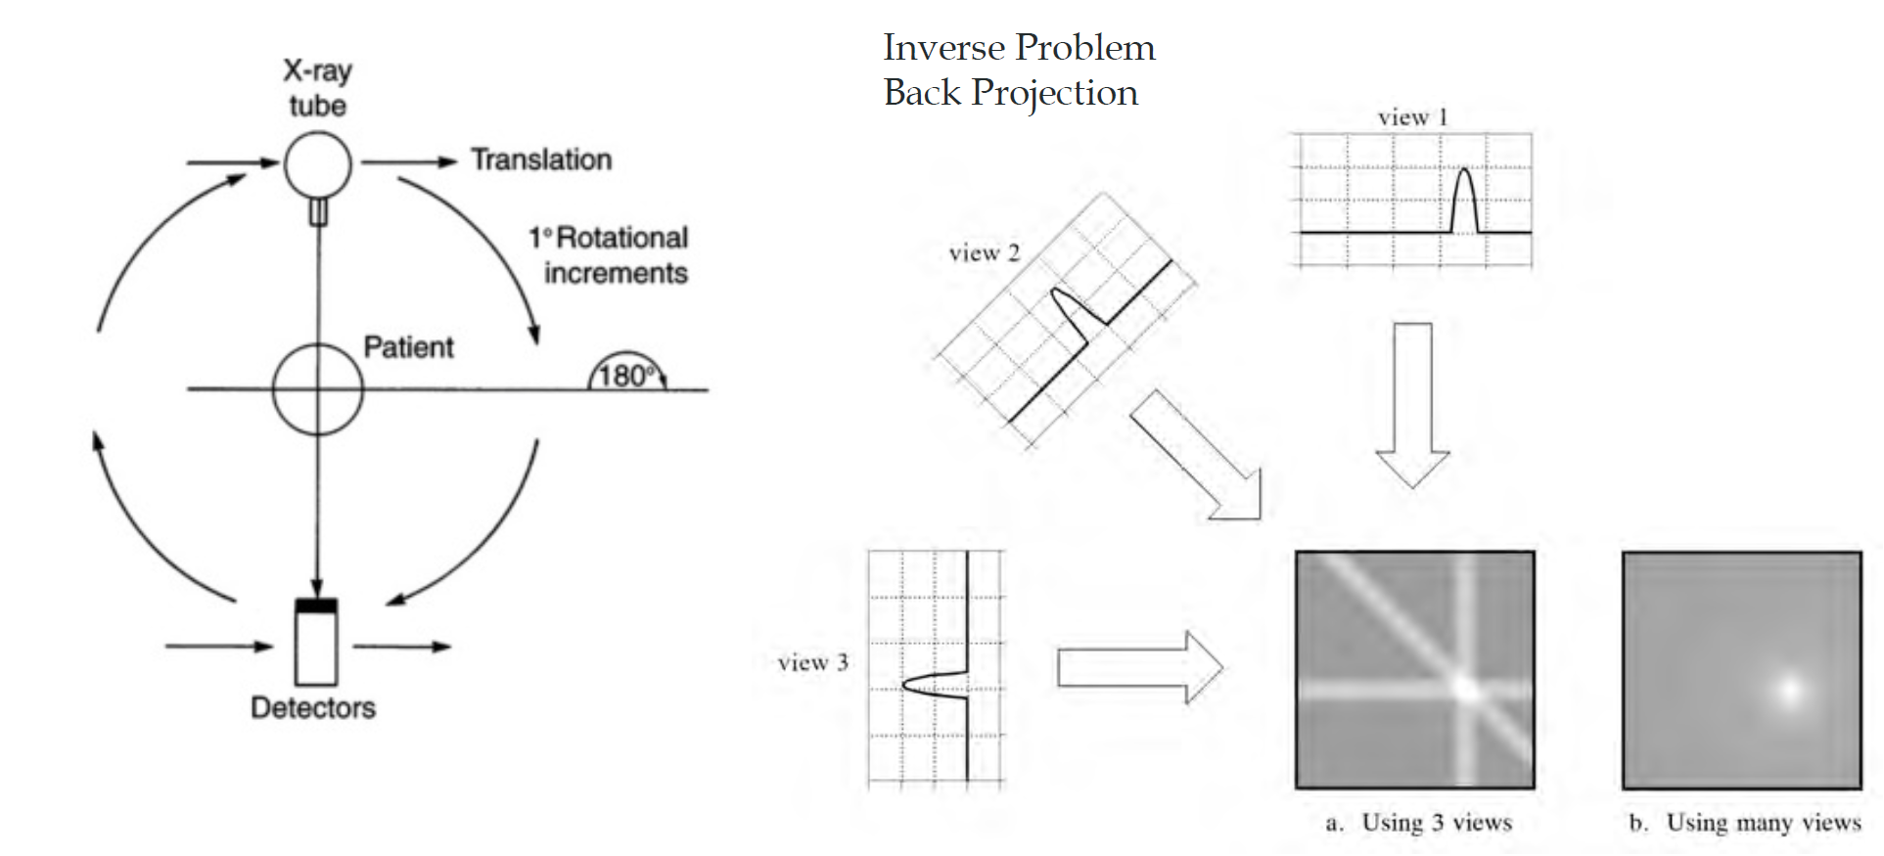
CT: Back Projection in Image Domain

Slide 8
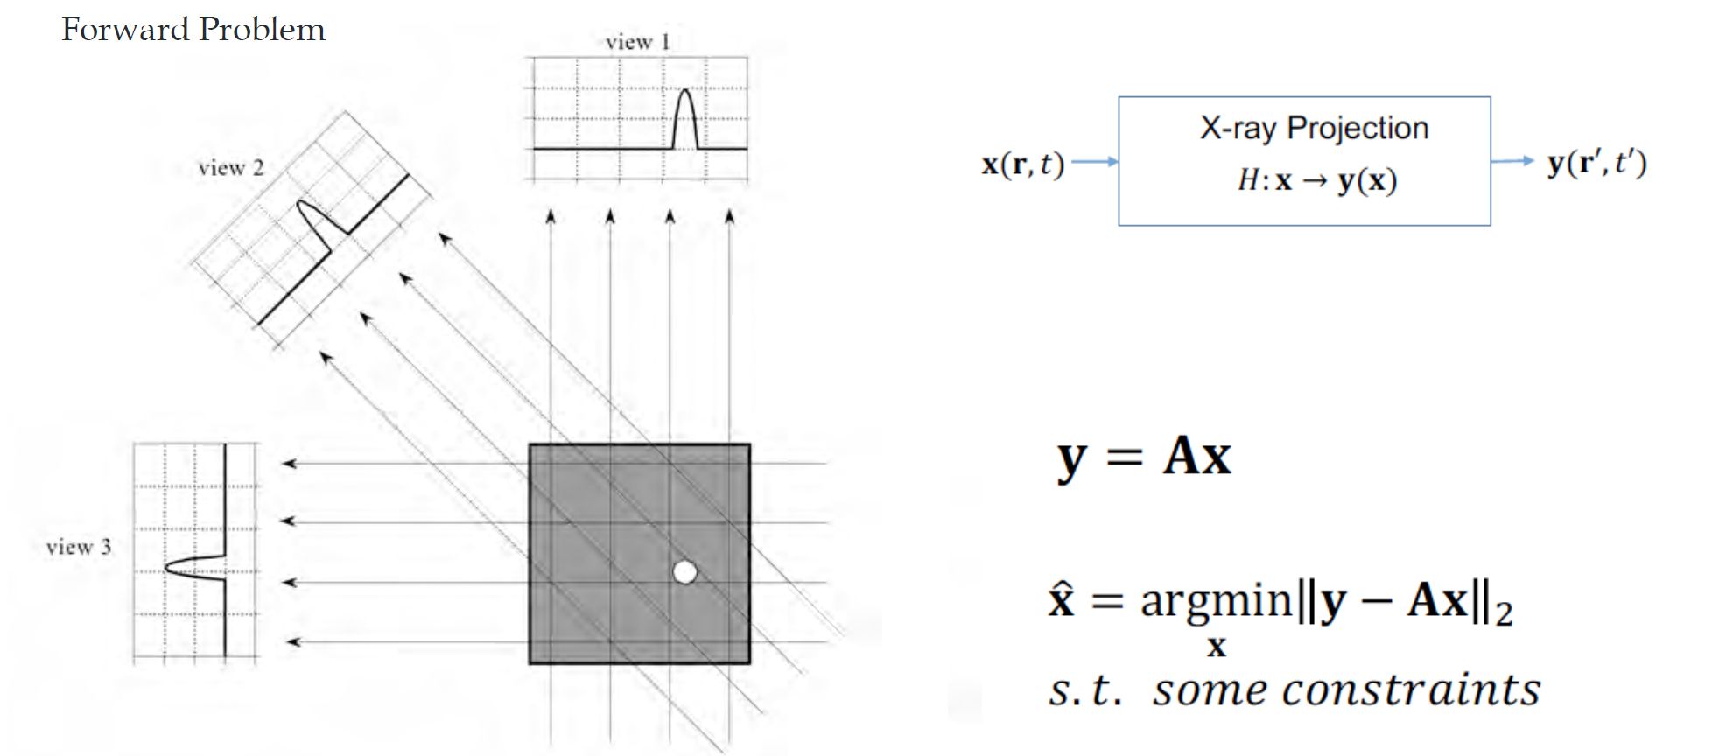
CT: Discrete Optimization Formulation

Slide 9
Radon Transform &
Fourier-Slice Theorem

Slide 10
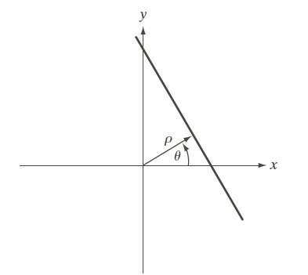

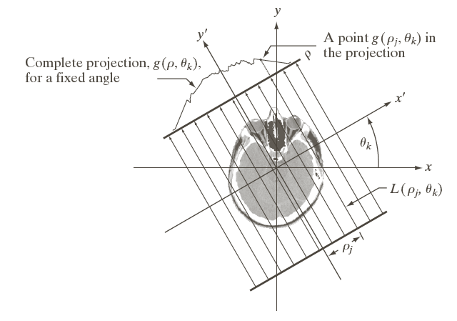
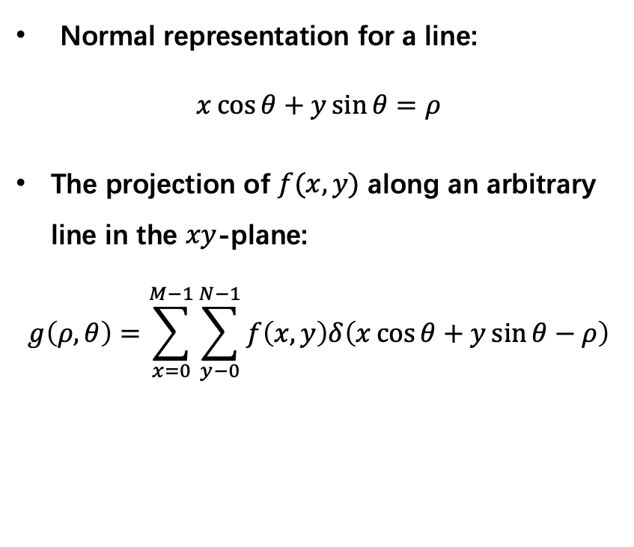
Radon Transform
Normal representation for a line:
$$x\cos{θ}+y\sin{θ}=ρ$$
The projection of $f(x,y)$ along an arbitrary line in the $xy$-plane:
$$g\left(ρ,θ\right)=\sum_{x=0}^{M−1}{\sum_{y−0}^{N−1}{f\left(x,y\right)δ\left(x\cos{θ}+y\sin{θ}−ρ\right)}}$$

Slide 11
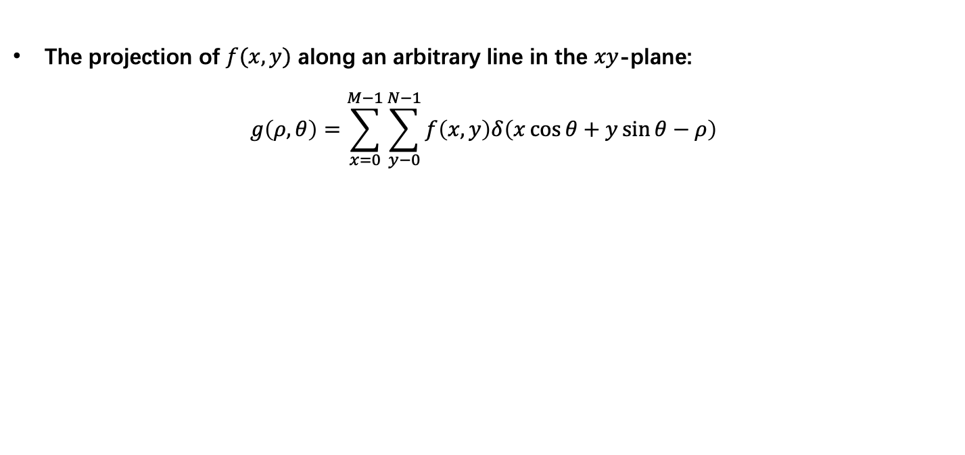


Radon Transform
The projection of $f(x,y)$ along an arbitrary line in the $xy$-plane:
$$g\left(ρ,θ\right)=\sum_{x=0}^{M−1}{\sum_{y−0}^{N−1}{f\left(x,y\right)δ\left(x\cos{θ}+y\sin{θ}−ρ\right)}}$$
Sinogram
$$f(x,y)$$
$$g (ρ,θ)$$

Slide 12
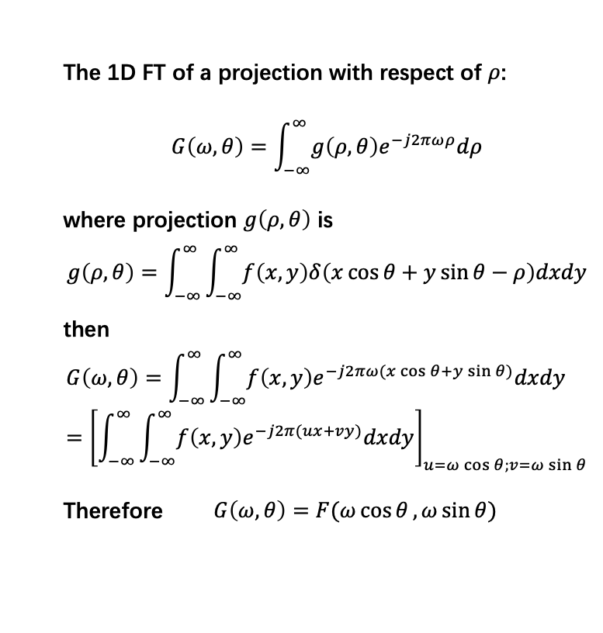
Fourier-Slice Theorem
The 1D FT of a projection with respect of $ρ$:
$$G\left(ω,θ\right)=\int_{−∞}^{∞}{g\left(ρ,θ\right)e^{−j2πωρ}dρ}$$
where projection $g\left(ρ,θ\right)$ is
$$g\left(ρ,θ\right)=\int_{−∞}^{∞}{\int_{−∞}^{∞}{f\left(x,y\right)δ\left(x\cos{θ}+y\sin{θ}−ρ\right)dxdy}}$$
then
$$G\left(ω,θ\right)=\int_{−∞}^{∞}{\int_{−∞}^{∞}{f\left(x,y\right)e^{−j2πω(x\cos{θ}+y\sin{θ})}dxdy}}={\left[\int_{−∞}^{∞}{\int_{−∞}^{∞}{f\left(x,y\right)e^{−j2π(ux+vy)}dxdy}}\right]}_{u=ω\cos{θ};v=ω\sin{θ}}$$
Therefore $G\left(ω,θ\right)=F(ω\cos{θ},ω\sin{θ})$

Slide 13
Filtered Back Projection

Slide 14
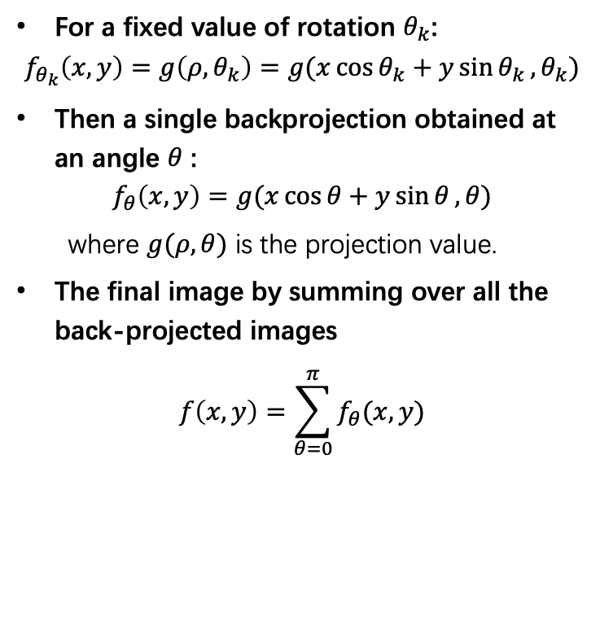
Back Projection from Radon Transform
For a fixed value of rotation $θ_{k}$:
$$f_{θ_{k}}\left(x,y\right)=g\left(ρ,θ_{k}\right)=g(x\cos{θ_{k}}+y\sin{θ_{k}},θ_{k})$$
Then a single backprojection obtained at an angle $θ$ :
$$f_{θ}\left(x,y\right)=g(x\cos{θ}+y\sin{θ},θ)$$
where $g(ρ,θ)$ is the projection value.
The final image by summing over all the back-projected images
$$f\left(x,y\right)=\sum_{θ=0}^{π}{f_{θ}(x,y)}$$

Slide 15
Back Projection from Radon Transform
BP

Slide 16
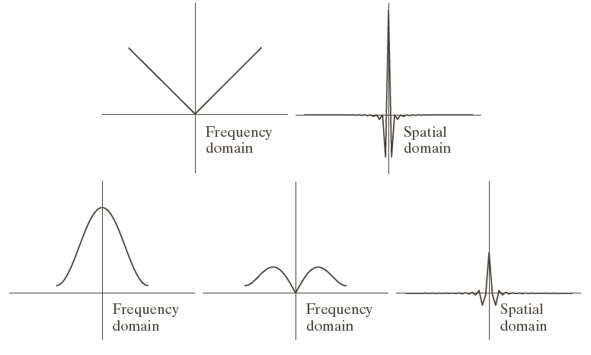
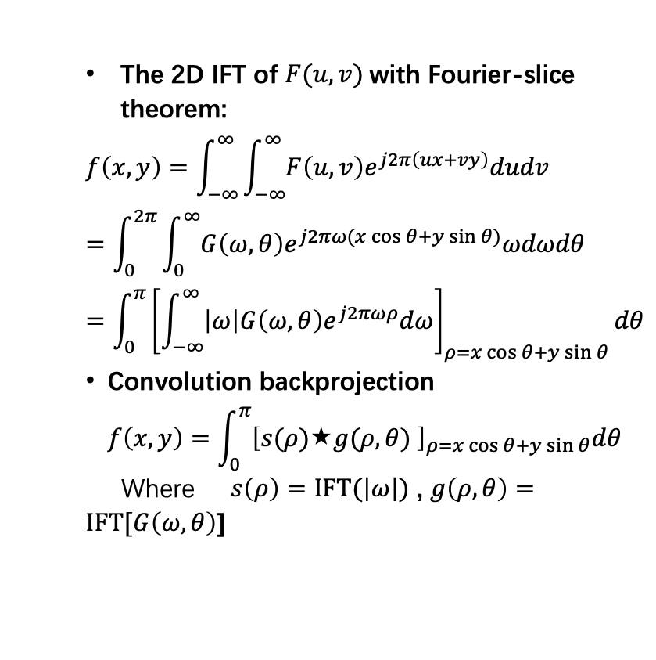
Parallel-Beam Filtered Back projections
The 2D IFT of $F(u,v)$with Fourier-slice theorem:
$$f\left(x,y\right)=\int_{−∞}^{∞}{\int_{−∞}^{∞}{F\left(u,v\right)e^{j2π\left(ux+vy\right)}dudv}}=\int_{0}^{2π}{\int_{0}^{∞}{G\left(ω,θ\right)e^{j2πω(x\cos{θ}+y\sin{θ})}ωdωdθ}}=\int_{0}^{π}{{\left[\int_{−∞}^{∞}{\left|ω\right|G\left(ω,θ\right)e^{j2πωρ}dω}\right]}_{ρ=x\cos{θ}+y\sin{θ}}dθ}$$
Convolution backprojection
$$f\left(x,y\right)=\int_{0}^{π}{{\left[s(ρ)↔g(ρ,θ) \right]}_{ρ=x\cos{θ}+y\sin{θ}}dθ}$$
Where $s\left(ρ\right)=\text{IFT}(\left|ω\right|)$ , $g\left(ρ,θ\right)=\text{IFT}[G\left(ω,θ\right)$]

Slide 17
Parallel-Beam Filtered Back projections

Slide 18
Common problems in tomography images

Slide 19
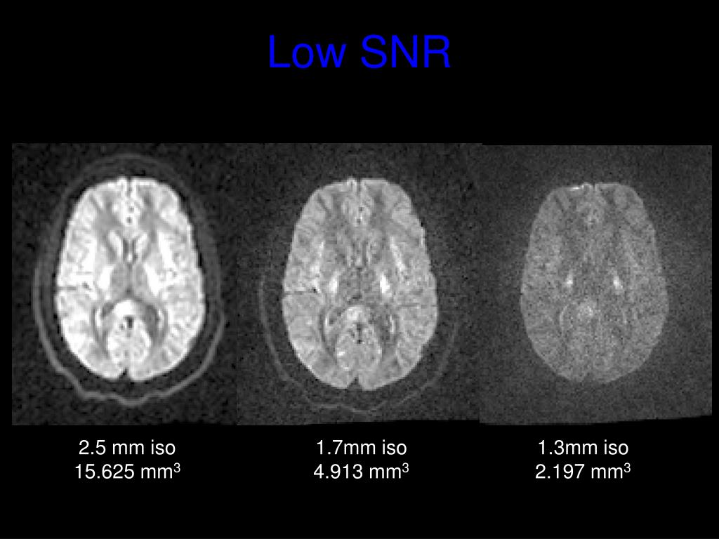
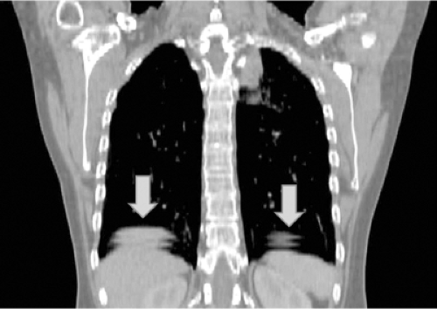
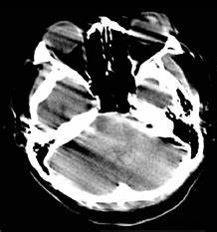
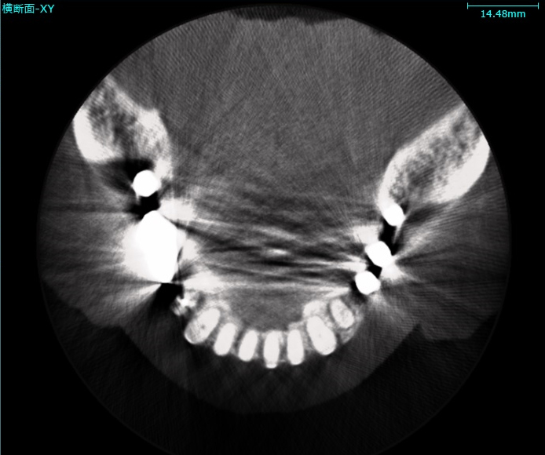
Common problems in tomography images
Tradeoff between image resolution, SNR and radiation exposure, equipment cost, scanning time…
Lack of anatomical detail on the inter-plane view.
Image artifact from of patient motion, metal implantation devices …

Slide 20
Common problems in tomography images
How to improve?
Methods on image reconstruction
Methods on image interpolation
Methods on image denoising
Methods on image motion correction
Methods on image inpainting

Slide 21
Our final question for you:
What we can improve using implicit neural representation network?
Now it is time for you to discuss and raise problems to us!

